Slide 1

2019.7.9
Antimicrobial stewardship program
(ASP) in NCGM
National Center for Global Health and Medicine
Disease Control and Prevention Center

Slide 2
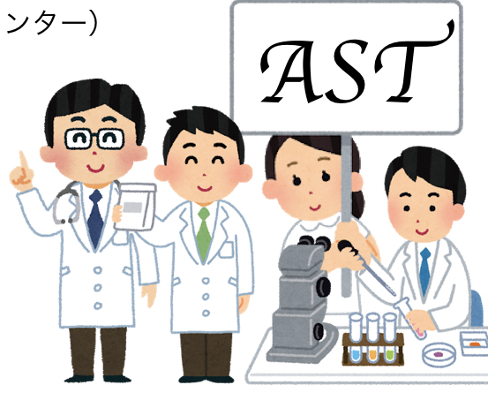
Our Team
・3 Doctor (2 ID, Pediatrician)
・2 Microbiological technicians
・2 Pharmacists
・1 Nurse

Slide 3
The purpose of ASP
・Reduce antimicrobial use without deteriorating patient prognosis

Slide 4

Why do we need to reduce the use of antibiotics?
Carbapenem ↑↑
→Carbapenem resistant bacteria : Acinetobacter sp ↑↑
Pseudomonas sp ↑↑
Enterobacteriaceae ↑↑

Slide 5
How to reduce the use of antimicrobials ?
・Monitoring of antimicrobial use
・Treatment support of carbapenem use case
・Antibacterial drug notification system
・Diagnostic stewardship

Slide 6
Monitoring of antimicrobial use

Slide 7
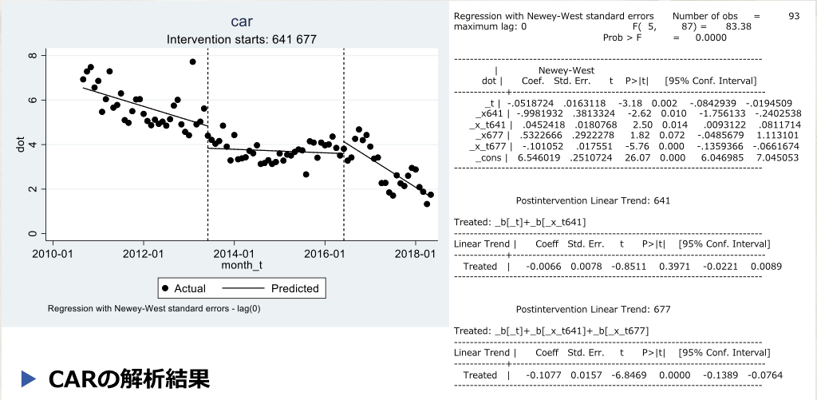

Slide 8
Treatment support of carbapenem use case

Slide 9
Treatment support
・Intervention in cases who carbapenem is prescribed for more than 3 days.
・Recommend de-escalation if possible .
・The infection consultation team regularly makes recommendations for continued carbapenem case.

Slide 10
Diagnostic stewardship

Slide 11
