Slide 1
Activities of AST at NCGM
National Center for Global Health and Medicine
Disease Control and Prevention Center

Slide 2
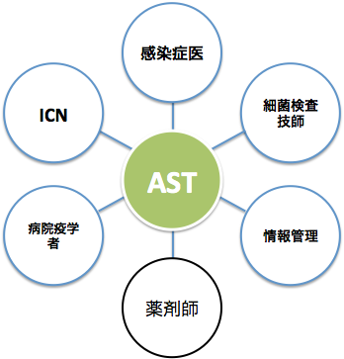
Antimicrobial Stewardship Team
Antimicrobial Stewardship Team
ICT can also be in charge concurrently
Reduce the amount of antimicrobial use without worsening patient prognosis
Also provide education for healthcare professionals, patients and general public
Infection control physician
Bacterial laboratory technician
ICN
AST
Hospital epidemiologist
Information management
Pharmacist

Slide 3
AST at NCGM
Leader physician (Infection control physician) ← Kutsuna
Physician (Infection control physician/pediatrician)
Physician (Pediatrician/AMR Clinical Reference Center)
Two bacterial laboratory technicians
Two pharmacists
Nurse

Slide 4
Basic activities
Infectious disease consultation
Investigation of the amount of antimicrobial use
Notification system/Authorization system
Management of drugs adopted in hospital
Preparation of antibiogram
Revision of the Guidelines for Antimicrobial Use

Slide 5
Proper antimicrobial use through infectious disease consultation
Recommend treatment discontinuation if no need for antimicrobial use
De-escalation if possible to switch to a narrow-spectrum antimicrobial drug
Define the antimicrobial treatment period
*However, priority should be placed on treating patients; therefore, recommendation should be made, if needed, to add antimicrobial drugs or escalate the dose, and to add tests, such as CD toxin test and CT scan, for finding the cause of infection.

Slide 6
Intervention for blood culture-positive patients
Gather in the microbiological laboratory at 9:30 every morning to review blood culture-positive patients (patients should be reviewed by on-call physicians on weekends)
Review the medical charts for positive patients.
  If an appropriate antimicrobial drug is not administered, call the attending physician to recommend an appropriate antimicrobial drug (e.g., additional VCM should be recommended if grape-shaped gram-positive cocci from 2/2 sets are positive).
  Recommend intervention through infectious disease consultation

Slide 7
Monitoring of Staphylococcus aureus bacteremia/Candida bacteremia
Clinical information: Age, sex, medical care information
Target bacteria: MSSA, MRSA, Candida
Endpoint: Presence/absence of at least 1 set of blood culture re-test, and infectious disease consultation within 1 week after the day of bacterial identification
Candida endpoint: Antifungal administration, and ophthalmology consultation (including scheduled consultation) by 24 hours after the time when the bacterium is detected
Staphylococcus aureus endpoint: Sensitive antimicrobial drug administration, and echocardiography (including transthoracic echocardiography, and scheduled echocardiography) by 24 hours after the time when the bacterium is detected
Definition of the day of bacterial identification:
  Candida: Date when yeast-like fungus was detected from blood culture (estimated from medical record or final report day -2 days)
  Staphylococcus aureus: Final report day
Publication: Case list, summary of 2 months

Slide 8
2017/10/23 - 10/29
Staphylococcus aureus
Age/Sex | Department | Bacterial strain | Blood culture re-test | CVC | CV removal | Consultation | Sensitive drug | Lesion
69M | Gastrointestinal medicine | MSSA | ○ | × |  | ○ | ○ | PLABSI
Candida
Age/Sex | Department | Blood culture re-test | CVC | CV removal | Consultation | Antifungal drug | Ophthalmology | Remarks
82F | Cardiovascular medicine | ○ | ○ (PICC) | ○ | ○ | ○ | ○ | CLABSI

Slide 9
Investigation of the amount of antimicrobial use

Slide 10
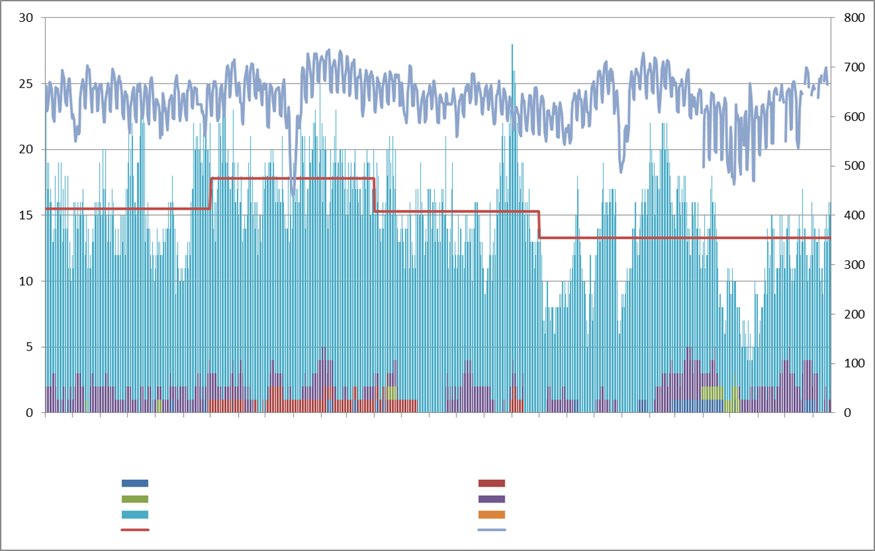
Changes over time in the number of patients using anti-MRSA drugs
<2016/04/01->
(patients)
(patients)
April 1 | May 1 | June 1 | July 1 | August 1 | September 1 | October 1 | November 1 | December 1 | January 1 | February 1 | March 1 | April 1 | May 1 | June 1 | July 1 | August 1 | September 1 | October 1 | November 1 | December 1 | January 1 | February 1 | March 1 | April 1 | May 1 | June 1 | July 1 | August 1
Cubicin IV 350 mg
Zyvox Tablets 600 mg
Zyvox Injection 600 mg/300 mL
Teicoplanin for IV Infusion 200 mg
Vancomycin for IV Infusion 0.5 g
Habekacin Injection 75 mg
Half-year mean
Number of inpatients

Slide 11
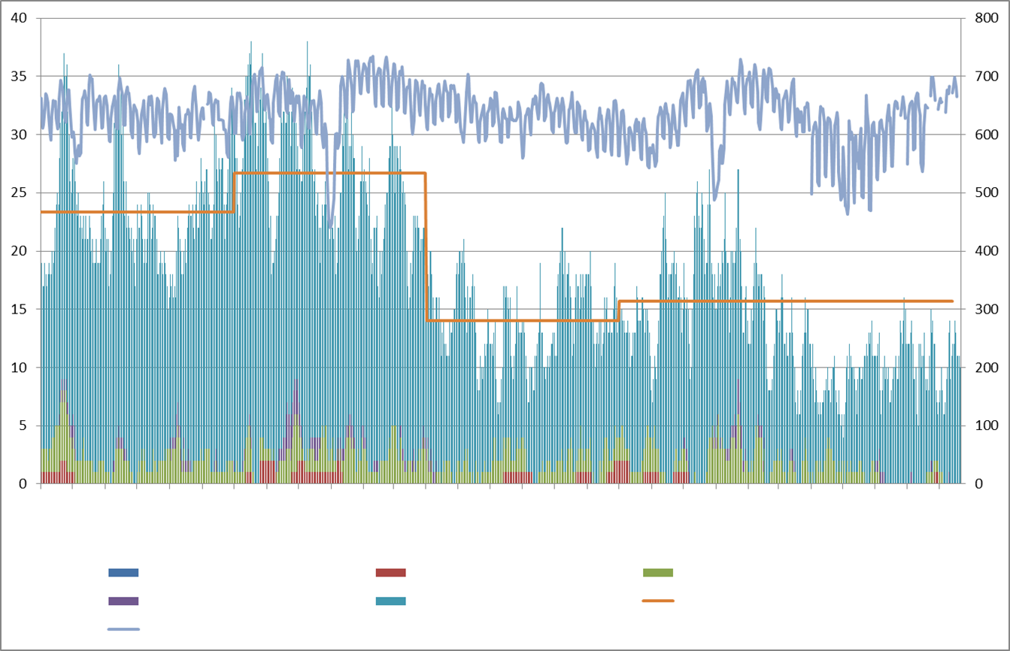
Changes over time in the number of patients using carbapenem antimicrobial drugs
<2016/04/01->
(patients)
(patients)
April 1 | May 1 | June 1 | July 1 | August 1 | September 1 | October 1 | November 1 | December 1 | January 1 | February 1 | March 1 | April 1 | May 1 | June 1 | July 1 | August 1 | September 1 | October 1 | November 1 | December 1 | January 1 | February 1 | March 1 | April 1 | May 1 | June 1 | July 1 | August 1
Carbenin for IV Drip Infusion 0.5 g
Tienam for IV Drip Infusion 0.5 g
Finibax for Drip Infusion 0.25 g
Meropen Vial for IV Drip Infusion 0.25 g
Meropen Vial for IV Drip Infusion 0.5 g
Half-year mean
Number of inpatients

Slide 12
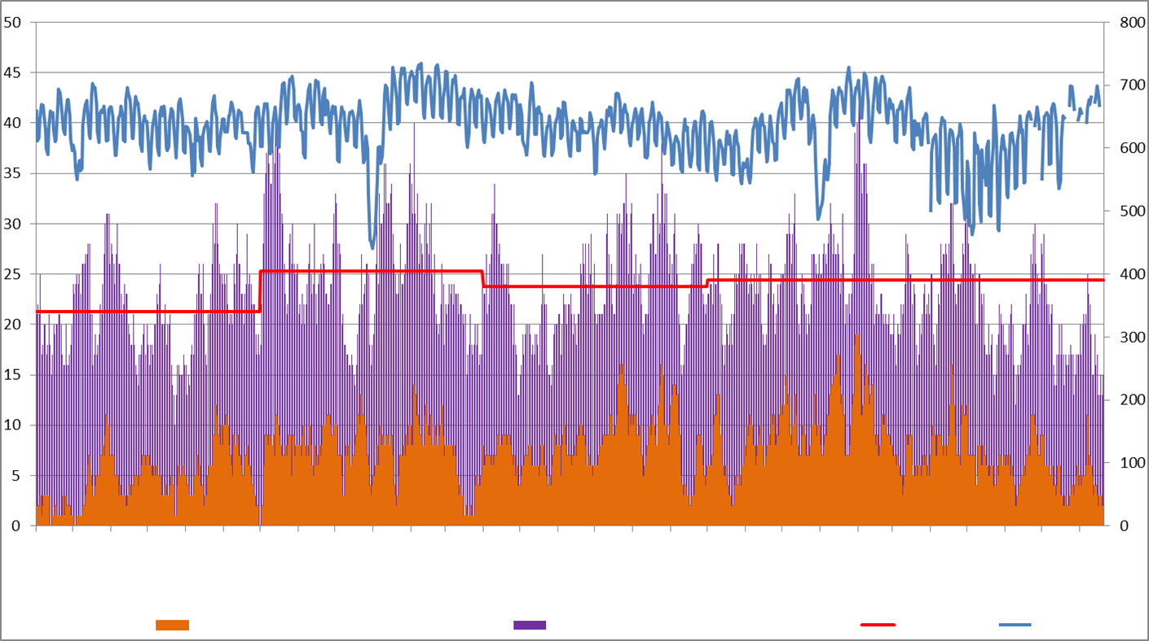
TAZ/PIPC (Tazopipe for IV Injection 4.5 g, 2.25 g)
Changes over time in the number of patients <04/01/2016- >
(patients)
(patients)
April 1 | May 1 | June 1 | July 1 | August 1 | September 1 | October 1 | November 1 | December 1 | January 1 | February 1 | March 1 | April 1 | May 1 | June 1 | July 1 | August 1 | September 1 | October 1 | November 1 | December 1 | January 1 | February 1 | March 1 | April 1 | May 1 | June 1 | July 1 | August 1
Zosyn (Tazopipe) for IV Injection 2.25 g
Zosyn (Tazopipe) for IV Injection 4.5 g
Half-year mean
Number of inpatients

Slide 13
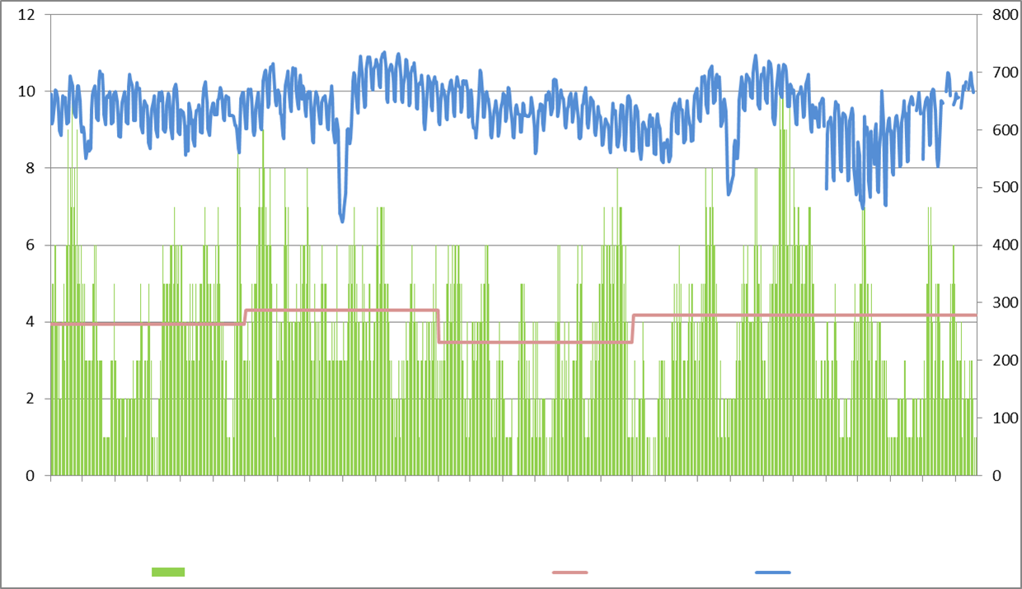
LVFX Injection (Cravit IV Drip Infusion Bag 500 mg)
Changes over time in the number of patients <04/01/2016- >
(patients)
(patients)
April 1 | May 1 | June 1 | July 1 | August 1 | September 1 | October 1 | November 1 | December 1 | January 1 | February 1 | March 1 | April 1 | May 1 | June 1 | July 1 | August 1 | September 1 | October 1 | November 1 | December 1 | January 1 | February 1 | March 1 | April 1 | May 1 | June 1 | July 1 | August 1
Cravit IV Drip Infusion Bag 500 mg/
Half-year mean
Number of inpatients

Slide 14
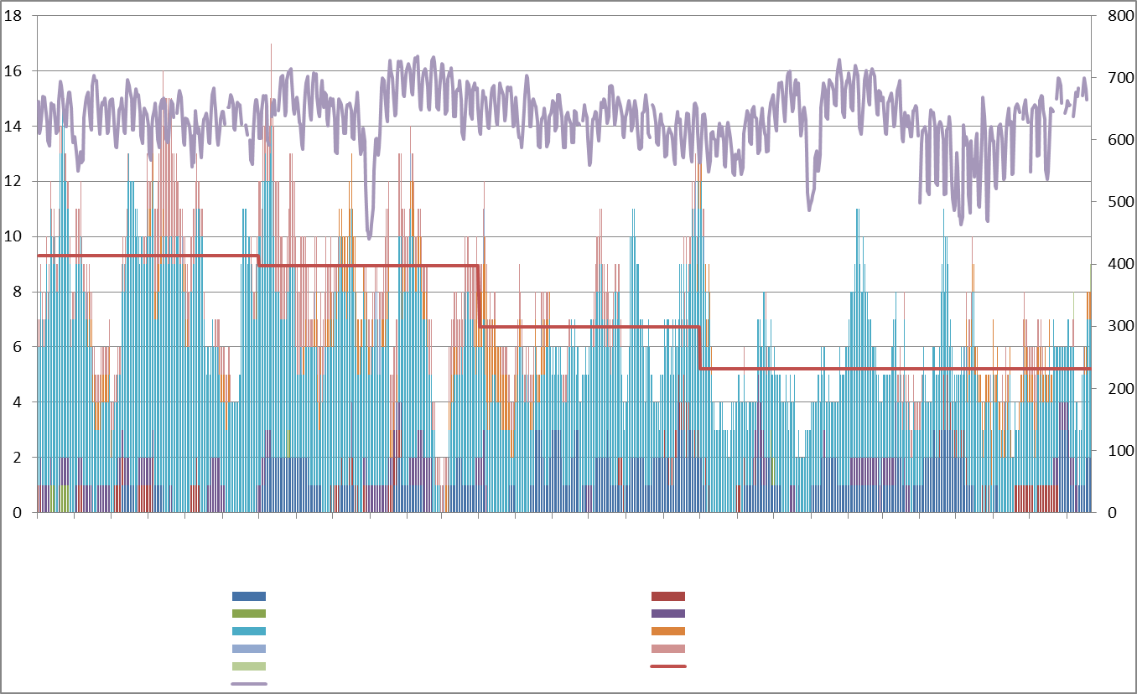
Changes over time in the number of patients using specific antifungal drugs
<2016/04/01->
(patients)
(patients)
April 1 | May 1 | June 1 | July 1 | August 1 | September 1 | October 1 | November 1 | December 1 | January 1 | February 1 | March 1 | April 1 | May 1 | June 1 | July 1 | August 1 | September 1 | October 1 | November 1 | December 1 | January 1 | February 1 | March 1 | April 1 | May 1 | June 1 | July 1 | August 1
Fluconazole IV Solution 0.2% 100 mg
Prodif IV Solution 200 mg/2.5 mL
Itrizole Injection 1% 200 mg/20 mL
Vfend for IV Use 200 mg
Funguard 50 mg for Infusion
Cancidas for IV Drip Infusion 50 mg
Cancidas for IV Drip Infusion 70 mg
AmBisome for IV Drip Infusion 50 mg
Fungizone Injection 50 mg
Half-year mean
Number of inpatients

Slide 15
Carbapenem monitoring
Started in April 2013
Confirmed the following information on patients treated with carbapenem
  Number of patients treated
  Department
  Culture collection (2 sets or 1 set of blood culture or no collection, presence/absence of specific culture collection)
Weekly feedback to all employees via in-house mail

Slide 16
11/6 - 11/12
Newly started: 20 patients (11 patients for the previous week)
No culture submitted: 5 patients (25.0%)
No culture at all: 1
Only 1 set of blood culture: 0
Specific culture only: 4
⇒All patients with dose escalation from other antimicrobial drugs

Slide 17
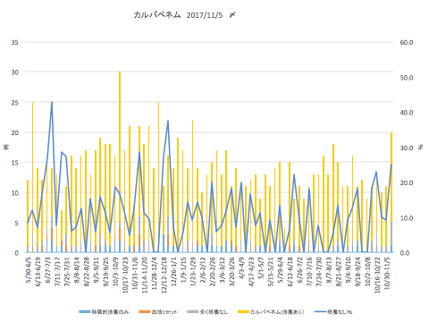
Carbapenem (up to 11/5/2017)
Percentage
Specific culture only
1 set of blood culture
No culture at all
Carbapenem (with culture)
No culture (%)

Slide 18
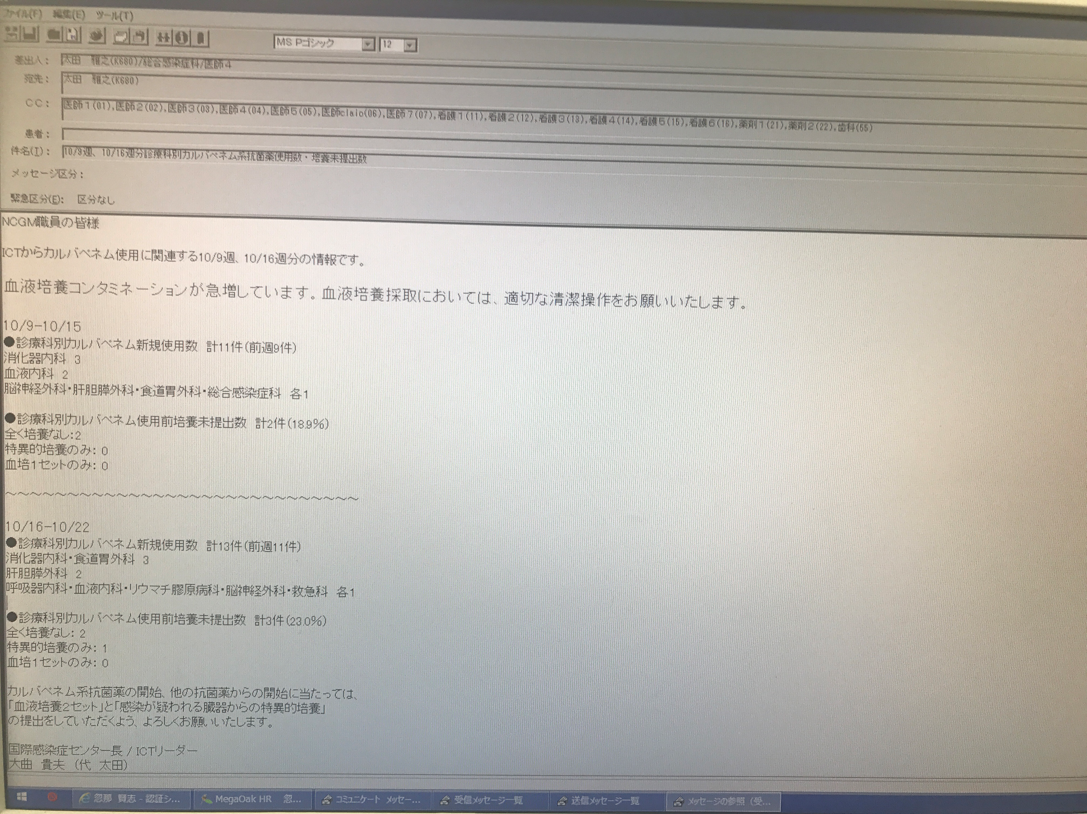
Emergency category (E): No category
Dear NCGM employees,
This is information from ICT on the use of carbapenem for the weeks starting on October 9, and October 16.
The incidence of blood culture contamination has been increasing rapidly. Please ensure appropriate cleaning operation during blood culture collection.
10/9-10/15
● Number of new carbapenem users by department: 11 in total (9 for the previous week)
Gastrointestinal medicine: 3
Hematology: 2
Neurosurgery, hepato-biliary-pancreatic surgery, esophageal-gastric surgery, and general infectious disease: 1 each
● Number of patients who did not submit culture before using carbapenem by department: 2 in total (18.9%)
No culture at all: 2
Specific culture only: 0
Only 1 set of blood culture: 0
10/16-10/22
● Number of new carbapenem users by department: 13 in total (11 for the previous week)
Gastroenterological medicine, esophageal-gastric surgery: 3
Hepato-biliary-pancreatic surgery: 2
Respiratory medicine, hematology, rheumatology, neurosurgery, and emergency: 1 each
● Number of patients who did not submit culture before using carbapenem by department: 3 in total (23.0%)
No culture at all: 2
Specific culture only: 1
Only 1 set of blood culture: 0
I would like to ask you to submit “2 sets of blood culture” and “specific culture from the organ suspected of infection” before starting treatment with carbapenem or other antimicrobial drugs.
ICT Leader, Director of Disease Control and Prevention Center
Norio Ohmagari (Deputy: Ohta)

Slide 19
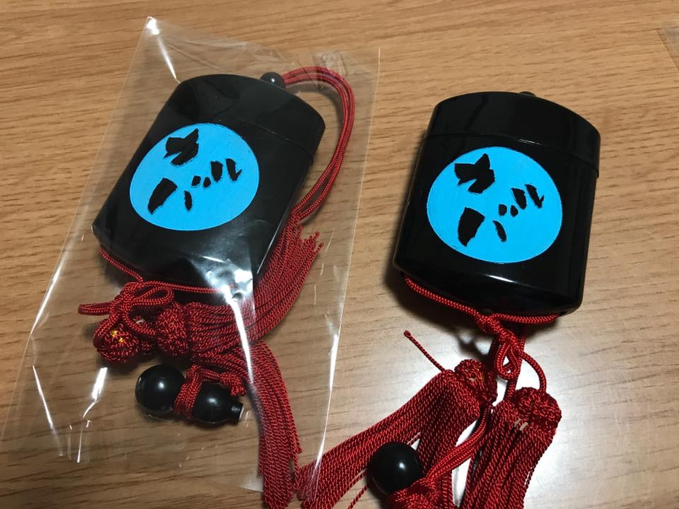
Carba Police
Intervention in patients for whom carbapenem is prescribed for 3 days or longer
(Surnamed “Carba Police” or “Meropen Police”)
Recommend de-escalation if possible
For continuing patients, the Infection Consultation Team provides recommendation on a regular basis

Slide 20

Case: Woman in her 90s
Woman with residual symptom of cerebral infarction hospitalized in a geriatric health services facility
The patient had presented with pyrexia for 9 days and visited our hospital 7 days before
She had pyuria and was diagnosed with urinary tract infection, and started to receive meropenem. Later, ESBL-producing E. coli was detected in her urine culture
Carba Police intervened as she had used carbapenem for 7 days

Slide 21

After intervention by Carba Police
As vital signs were stable, she was recommended to switch to cefmetazole
Completed a total of 10 days of treatment in combination with meropenem

Slide 22
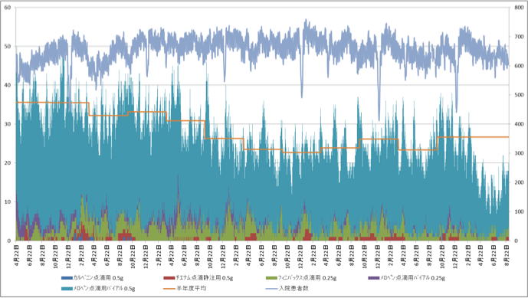
The amount of carbapenem used by NCGM has been reduced by around 50% from 2012 to 2017
April 22 | June 22 | August 22 | October 22 | December 22 | February 22 | April 22 | June 22 | August 22 | October 22 | December 22 | February 22 | April 22 | June 22 | August 22 | October 22 | December 22 | February 22 | April 22 | June 22 | August 22 | October 22 | December 22 | February 22 | April 22 | June 22 | August 22 | October 22 | December 22 | February 22 | April 22 | June 22 | August 22 | October 22 | December 22 | February 22 | April 22 | June 22 | August 22
Carbenin for IV Drip Infusion 0.5 g
Tienam for IV Drip Infusion 0.5 g
Finibax for Drip Infusion 0.25 g
Meropen Vial for IV Drip Infusion 0.25 g
Meropen Vial for IV Drip Infusion 0.5 g
Half-year mean
Number of inpatients

Slide 23
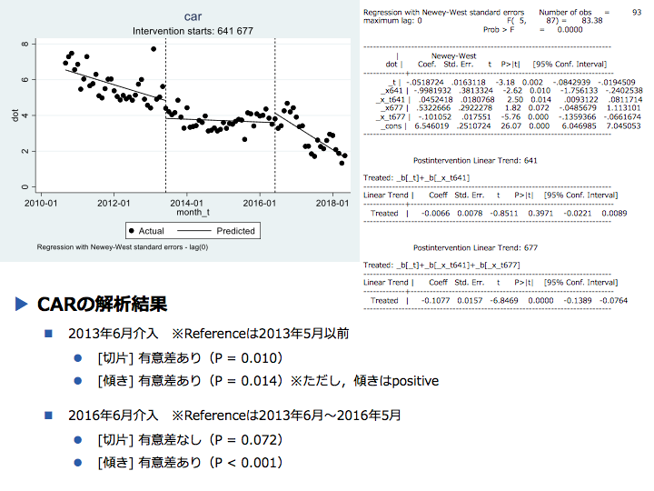
◆ Results of analysis on CAR
Intervention in June 2013 *Reference: Before May 2013
[Intercept] Significant difference (P = 0.010)
[Slope] Significant difference (P = 0.014) * However, the slope is positive
Intervention in June 2016 *Reference: June 2013 to May 2016
[Intercept] No significant difference (P = 0.072)
[slope] Significant difference (P < 0.001 )

Slide 24
Number of CREs detected

Slide 25
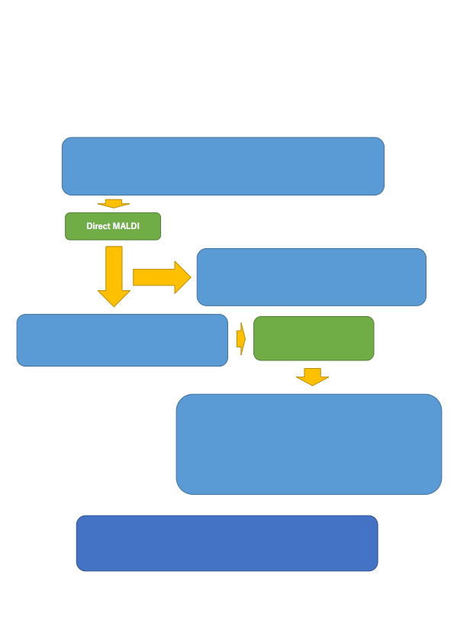
Direct MALDI
+Verigene
Flow of testing positive blood culture samples on the premise of starting early bacterial identification by MALDI-ToF using Rapid BACproll (hereinafter "Direct MALDI")
*Changes only in GPC cluster
(1) Blood culture positive for Staphylococci (regardless of the number of sets)
Only for samples that had been positive at the start of service
*Because the flow to Verigene cannot be guaranteed when the result turned positive later
If blood culture turns positive for Staphylococcus, perform (1) Direct MALDI and (2) Verigene
(2) For CoNS
When 1 set is positive: Handled as contamination as a general rule
If 2 sets are positive: Treatment with glycopeptide is recommended
(3) In the following cases:
For S.aureus, S.lugdunensis
When there is no candidate bacteria with a MALDI score ≥ 2.0
Call the responsible department and perform Verigene
(4) See Verigene results
In case of S.aureus: Consultation for all cases
For CoNS: Refer to (2)
For S.lugdunensis: Recommend consultation as described below:
MR: Glycopeptide; MS: Cephem (1 or 3 generations)
Other cases → Consider NVS and obligate anaerobe, and take responsive measures according to the situation.
(5) Positive blood culture during service hours at a timing that does not fall under (1)
After discussion between the clinical department and laboratory, determine the tests to be performed (The above flow should not be applicable) (Verigene should be ordered by 14:00 as a general rule)

Slide 26

Case: Woman aged 82 years
Chief complaint: Pyrexia
History of present illness: TKA was performed 5 days ago for left gonarthrosis. After that, the clinical course had been uneventful; however, the patient had chills and pyrexia of 38.4ºC from the early morning of the day and called the attending physician
Physical findings: BT 38.4ºC, BP 145/102, PR 112, SpO2 96% (room air)
Redness and tenderness were noted at the site of peripheral catheter insertion on the right forearm

Slide 27
Antimicrobial drug notification system/Authorization system
 | Notification system | Authorization system
From March 2014 | Vancomycin, Teicoplanin, Meropenem, Doripenem | Linezolid Daptomycin
From September 2014 | + Levofloxacin (injection) Piperacillin-tazobactam
From July 2015 | + Antifungal drug (injection)
From April 2016 |  | + Colistin
From June 2018 |  | + Baloxavir marboxil

Slide 28
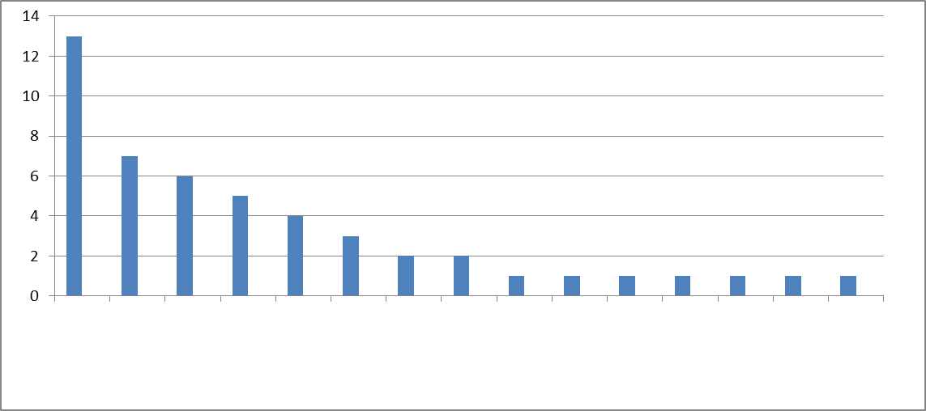
Submission rate of notification of the use of specified antimicrobial drugs/antifungal drugs
2017/3/13- 3/19
Submission rate
This week: 100% (49/49) Last week: 100% (46/46)
Number of unsubmissions by department: 0
(cases)
■Number of submissions
■Number of unsubmissions
Surgery
Hematology
Gastrointestinal medicine
Neurosurgery
Emergency
Respiratory medicine
Collagen medicine
Internal medicine
Cardiovascular surgery
DCC
Neonatal medicine
Respiratory surgery
Urology
General practice
Neurology

Slide 29
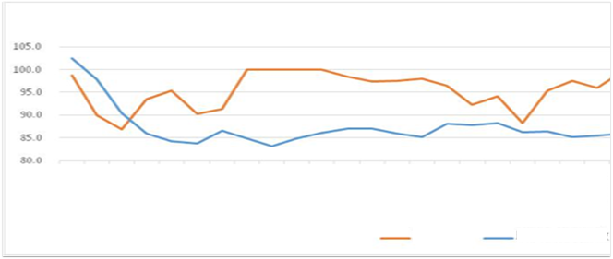
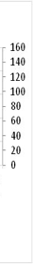
Changes over time in the control by notification system
September 2014 | October 2014 | November 2014 | December 2014 | January 2015 | February 2015 | March 2015 | April 2015 | May 2015 | June 2015 | July 2015 | August 2015 | September 2015 | October 2015 | November 2015 | December 2015 | January 2016 | February 2016 | March 2016 | April 2016 | May 2016 | June 2016
Submission rate
Frequency of reminder to submit notification
Chart: Prepared by Oku/Akazawa, Department of Pharmacy, National Center for Global Health and Medicine

Slide 30
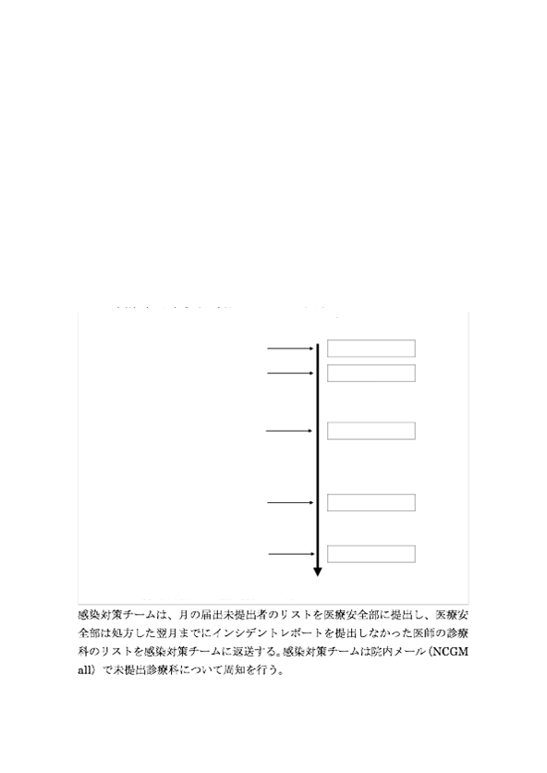
Plan to obligate those who have not submitted notifications of antimicrobial drug use to prepare incident reports
Infection Control Team
In September 2014, the National Center for Global Health and Medicine launched a notification system that require notification to the pharmacy when using broad-spectrum antimicrobial drugs and anti-MRSA drugs. Medical surveillance requires achievement of the notification rate of 100%; however, the notification rate at our hospital is still around 90%, and the notification rate remains low for specific departments under the current circumstances.
In addition, from the viewpoint of medical safety, it is suggested to be an incident to use antimicrobial drugs that should be notified, and followed and controlled by the infection control team without notification. For this reason, it is considered necessary to mandate physicians who do not submit notification before administering antimicrobial drugs requiring notification to submit incident reports.
Specifically, we will warn the physicians according to the following flow:
Timeline
Prescription of specific antimicrobial drugs
Day of prescription
Reminder of notification (1st)
Day following the prescription
Warn the attending physician that "the event will be handled as an incident if not notified"
Reminder of notification (2nd)
End of month
Warn the attending physician that "the event will be reported to the Medical Safety Management Office if notification is not submitted within this month"
Preparation of a list of physicians who have not submitted notification in the previous month
Date of ICC meeting
Submit the list to Medical Safety Department
Report of physicians who have not submitted incident report
End of next month
Medical Safety Department receives the list of physicians who have not submitted incident report, and report it at the next ICC meeting to disseminate the information by in-hospital mail
The Infection Control Team submits the monthly list of physicians who have not submitted the report to the Medical Safety Department, and the Medical Safety Department returns the list of physicians who have not submitted the incident report to the Infection Control Team by the end of the month following the prescription. The Infection Control Team disseminates the information on the departments that have not submitted the report via in-hospital mail (NCGM all).

Slide 31
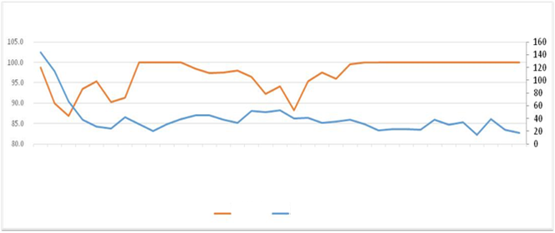
Plan to obligate submission of incident report
Changes over time in the control by notification system
September 2014 | October 2014 | November 2014 | December 2014 | January 2015 | February 2015 | March 2015 | April 2015 | May 2015 | June 2015 | July 2015 | August 2015 | September 2015 | October 2015 | November 2015 | December 2015 | January 2016 | February 2016 | March 2016 | April 2016 | May 2016 | June 2016 | July 2016 | August 2016 | September 2016 | October 2016 | November 2016 | December 2016 | January 2017 | February 2017 | March 2017 | April 2017 | May 2017 | June 2017 | July 2017
Submission rate
Frequency of reminder to submit notification
Chart: Prepared by Oku/Akazawa, Department of Pharmacy, National Center for Global Health and Medicine

Slide 32
20180703 ICC
AST ⬄ Pharmaceutical Committee: Review of adopted antimicrobial drugs
Flow chart for adoption/deletion and management of antimicrobial drugs
Definition of antimicrobial drugs: All kinds of antimicrobial drug including antiviral drugs and antiprotozoal drugs (excluding antiseptics)
When the applicant submits an application for adoption/deletion of an antimicrobial drug, it is desirable to inquire AST before submitting the application to the Pharmaceutical Committee Secretariat.
If the applicant submitted the application to the Pharmaceutical Committee Secretariat before inquiring AST, the application is reviewed by the Pharmaceutical Committee after inquiring AST
* Application documents shall be in compliance with the requirements for
each application document stipulated by the Pharmaceutical Committee
Applicant
Application for adoption and deletion of antimicrobial drugs
Application
* Adoption/use, etc. shall be in compliance with the detailed rules stipulated by the Pharmaceutical Committee
Applicant makes application
Inquiry
Antimicrobial Stewardship Team
(AST)
Pharmaceutical Committee Secretariat
Deadline for application: Wednesday in the first week of every month as a general rule
Response
ICT/AST Joint Meeting
(Committee)
Proposal/approval
Inquiry
Timing: Every Tuesday
Review, approval
Preparation for review
Next month: After approval/in-hospital notification
Pharmaceutical Committee
Adoption → Prescription is permissible
Deletion → Prescription is prohibited after using up the in-hospital inventory
Timing: Thursday in the third week of every month (Except August)
Review, examination and final decision

Slide 33
Cascade reporting of sensitivity
Staphylococcus aureus
PCG | S
MPIPC | S
ABPC | S
CEZ | S
CFX | S
ABK | S
GM | S
EM | S
CLDM | S
MINO | S
VCM | S
TEIC | S
LZD | S
CPFX | S
ST | S
MUP | S
DAP | S
Staphylococcus aureus(MSSA)
CEZ | S
GM | S
EM | S
CLDM | S
MINO | S
VCM | S
Staphylococcus aureus(MRSA)
PCG | R
ABPC | R
CEZ | R
CLDM | R
VCM | S
TEIC | S
MINO | R
ST | S

Slide 34
Take Home Message
In Japan, an increasing number of medical institutions have established their AST nationwide since an additional premium has been paid for the Antimicrobial Stewardship Team.
In general, the team is in charge of antibiogram preparation, monitoring of the dose of antimicrobial drugs, notification/permission system of antimicrobial drugs, and intervention for patients with positive blood culture.
Intervention for broad-spectrum antimicrobial users is effective in reducing the amount of antimicrobial use.
The key is to share jobs among physicians, pharmacists, laboratory technicians, and nurses according to their expertise.

