Slide 1

Hand hygiene
National Center for Global Health and Medicine
Disease Control and Prevention Center

Slide 2
The purpose of Hand hygiene
・Decrease in nosocomial infection prevalence
・Decrease in MRSA incidence
・Cost reduction

Slide 3
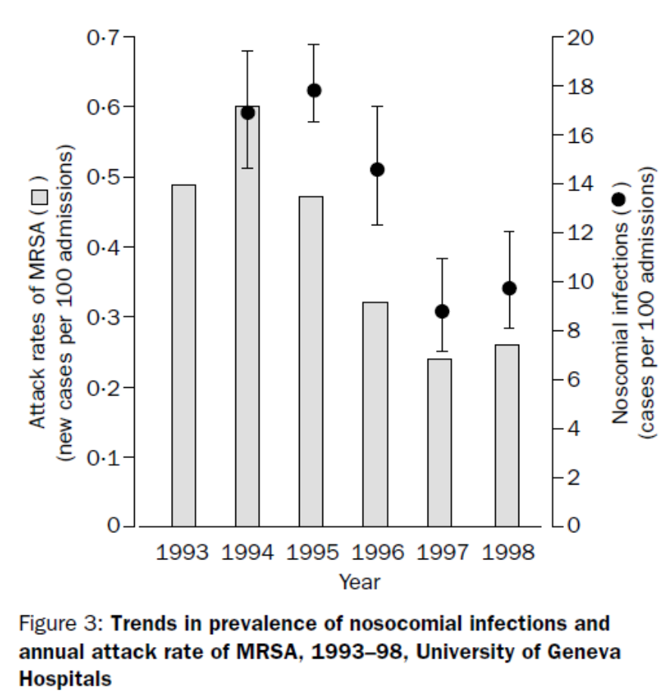
Decrease in nosocomial infection prevalence
Lancet, 356(9238): 1307-1312, 2000

Slide 4
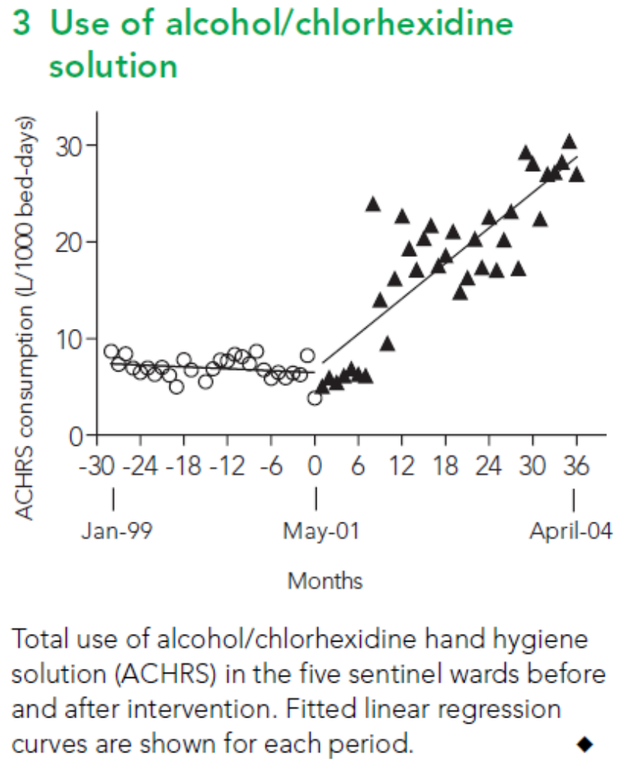
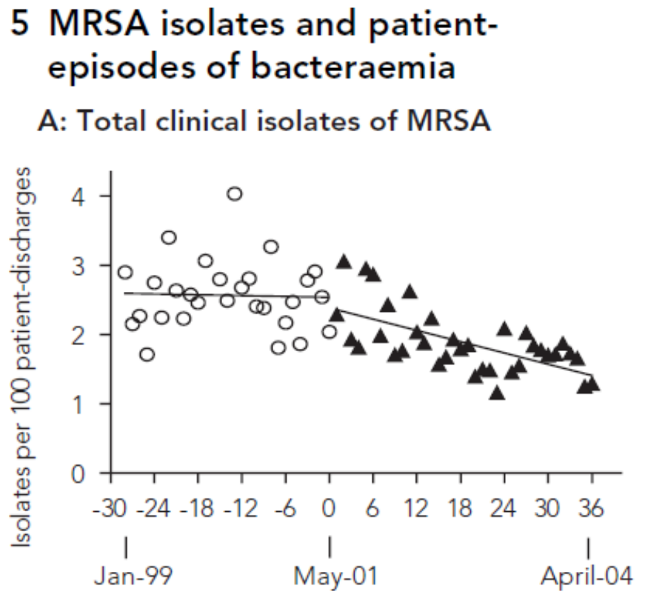
Decrease in MRSA incidence
Med J Aust, 183(10): 509-514, 2005

Slide 5
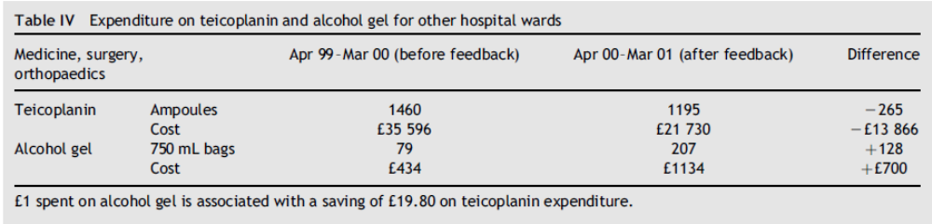
Cost reduction
-￡13,166
≒232,176,045 IDR/year
J Hosp Infect. 2004 Jan;56(1):56-63.

Slide 6
How to develop monitoring and evaluation
・Observation of staff hand hygiene method
・Increase hand hygiene alcohol
installation place
・Alcohol consumption monitoring

Slide 7

Observation of staff hand hygiene method
Hand wash checker
The wash left glows blue

Slide 8
Increase hand hygiene alcohol installation place

Slide 9

Alcohol consumption monitoring

Slide 10
Open discussion

