Slide 1

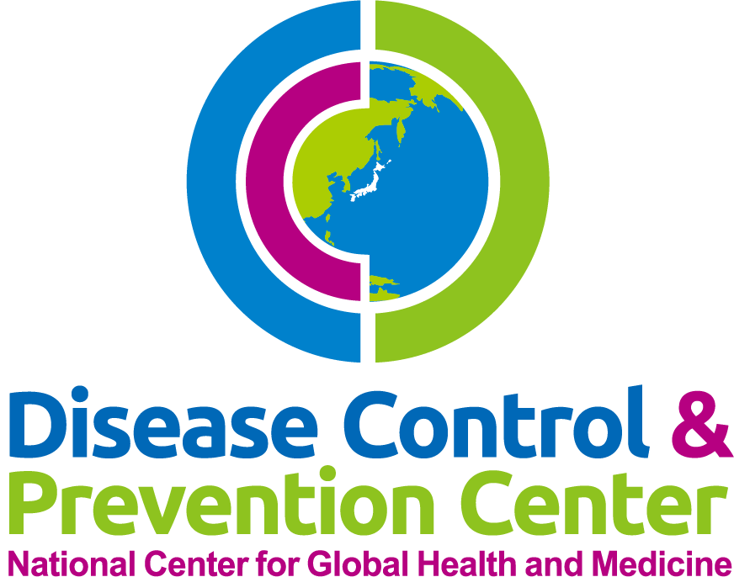
Oral Care
National Center for Global Health and Medicine
Disease Control and Prevention Center

Slide 2
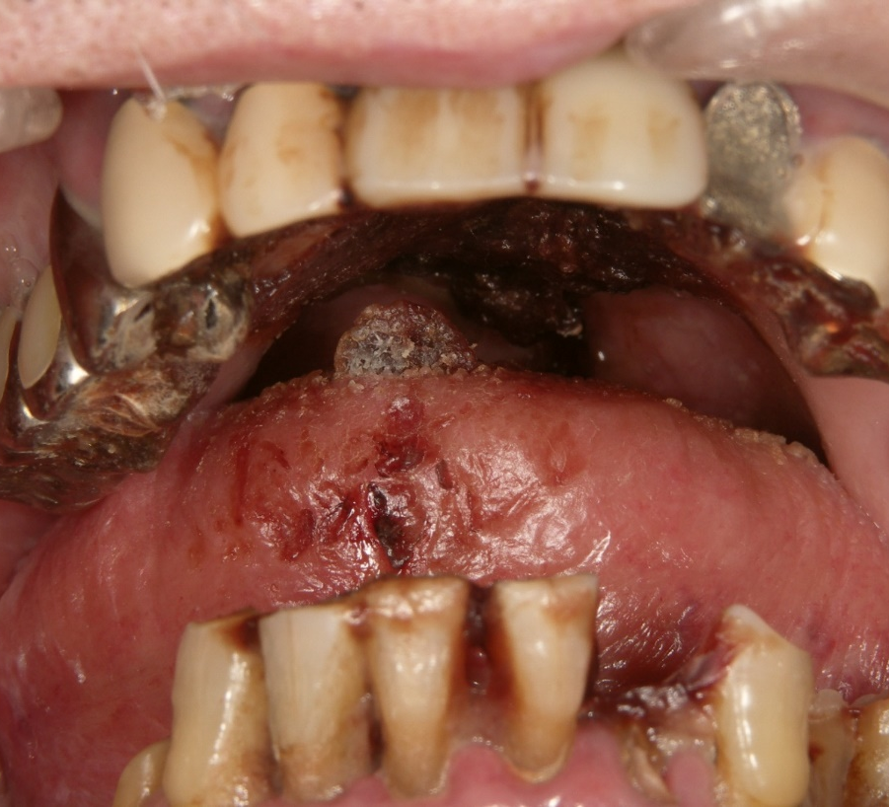
Oral Care Does Not Mean Tooth Brushing.
Oral Care is a means of improving the QOL of the patient by maintaining or restoring oral functions.
Oral care is effective in preventing…
  Aspiration pneumonia
  Ventilator associated pneumonia (intubated patients)
  Oral mucosa lesions
  General complications resulted from oral infections

Slide 3

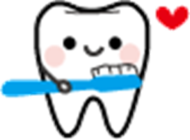
Oral Care and aspiration pneumonia
Oral care intervention proved to reduce the likelihood of developing aspiration pneumonia.
＊；P＜0.05
Yoneyama et al., A Study of the Effects of Oral Health Care on the Prevention of Aspiration Pneumonia in the Compromised Elderly Patients．
Journal of the Japanese Association for Dental Science，20：58-68，2001．

Slide 4
Oral Cavity Environment
Three Ideal factors for bacterial growth
Always around 37℃ (Temperature)
Constantly bathed by saliva (Moisture)
Food intake (Nutrition)
Oral cavity serves as a suitable environment for the formation and growth of microbe.
Oral care is important to maintaining healthy oral cavity.

Slide 5
Microorganisms in the oral cavity
Dental biofilm (plaque) contains 1~2.5 × 10¹¹ microorganisms.
Ex) Bacterial count per gram.
  Stomach: 1×10³
  Large intestine: 1×10¹¹
Oral Cavity is the most densely populated site with microorganism in human body.

Slide 6
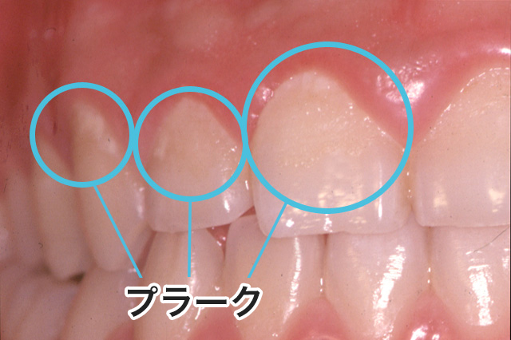
Plaque Biofilm
Plaque does not mean food particles but a mass of bacteria.
  Biofilm indicates a slimy layer of microorganisms, and is commonly observed in our daily life such as at a kitchen sink.
Plaque control can only be achieved by mechanical removal.
⇒Oral Care should be provided.
Plaque

